Slide 1
VMF Overview w/ CBM+ Focus
Mark.j.majkowski.civ@mail.mil
443-861-9096
CECOM SEC

Slide 2
VMF Overview and CBM+ Specific Questions
What is VMF?
Who uses VMF?
What is it used for?
What systems currently support it?
How is VMF governed?
How do new message types or variants get proposed/approved, who has
authority?
What representations of the messages exist
Binary Fields/Bytes/Bits, XML, other?
What Summary Information is Conveyed by the 3 VMF messages CBM is Considering Using (5.14, 7.3, 7.12)?
What Tools are Available for VMF message creation or reading?
SDK’s, Message Generation, Message Parsing, Validation Services or
Packages?
* Joint TDES Migration Plan, (JTMP), Oct 2008

Slide 3
What is VMF?
The Variable Message Format (VMF) Military Standard (MIL-STD) provides military services and agencies with a Joint interoperability standardization, including message, data element, and protocol standards. These standards are essential for the design, development, test, certification, fielding, and continued operation of automated tactical data systems (TDSs) which support the requirement to exchange timely, critical, command and control information across Joint boundaries.
The VMF Standard (MIL-STD-6017) represents physical schemas (DIV-3), structured information exchange requirements.
VMF specifies the data content and data format of tactical information for digital interoperability from the tactical-edge to/from the TOC.
The origin of VMF dates back to the early/mid nineties, when the Army/Joint Services began migration from Voice templates to human and system based digital communication.
* Joint TDES Migration Plan, (JTMP), Oct 2008

Slide 4
What is VMF?
The VMF Specification, MIL-STD-6017, is a TV-1, DISR mandated standard for Joint Interoperability.
VMF is a primary driver for ASA Acquisition life-cycle development of tactical system/platform Capability Sets.
The approved Interface Change Proposals are published approximately
every two years to establish a new version baseline for the TV-1
* Joint TDES Migration Plan, (JTMP), Oct 2008

Slide 5
What is VMF?
It is a C2/SA tactical messaging standard that supports message exchanges for the following functional areas:
Network Control Operations (K00)
General Information (K01)
Fire Support Operation (inclusive of Close Air Support) (K02)
Air Operations (K03)
Intelligence Operations (K04)
Land Combat Operations (K05)
Combat Service Support (Medical and Logistics) (K07)
Special Operations (K08)
Air Defense (K10)
There are approximately 140 messages in MIL-STD-6017, version C.
Messages are modified/added/corrected as the result of changes and interpretation of Army and Joint level doctrinal publications of Tactics, Techniques, and Procedures.
* Joint TDES Migration Plan, (JTMP), Oct 2008

Slide 6
How does VMF Align with Other Tactical Standards?
Link 16
Link 22
VMF
IBS (US)
Link 11 (and other TDLs)
Standards:
Tactical Data Link (TDL) Standards
US Message Text Formats (USMTFs)
Users:
TDLs fielded in over 70,000* platform implementations (2006). Projected to be over 110,000* by 2015.
USMTF distributed to over 10,000 end users.
Joint Family
of TDLs
* Joint TDES Migration Plan, (JTMP), Oct 2008

Slide 7
Joint Services Systems that Implement TDL STDs - Interoperability through TDL Messaging

Slide 8


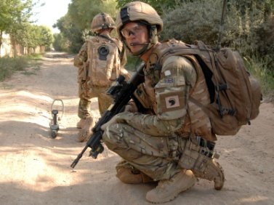
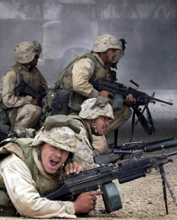
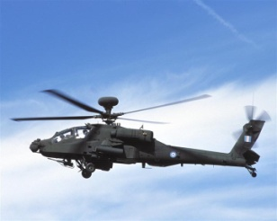


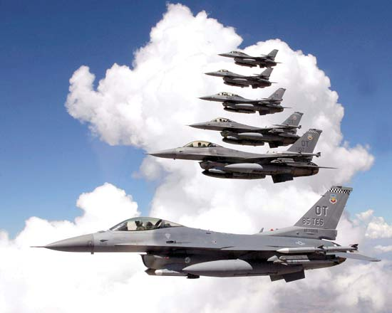

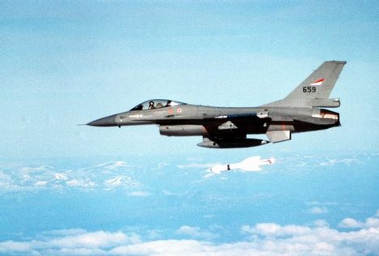



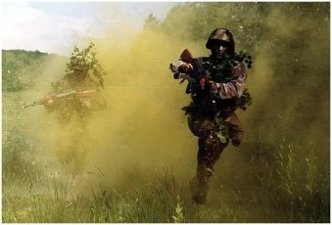




Who Uses VMF - Joint/Allied Interoperability through Messaging
Messages MUST be interoperable across multiple distinct platforms supporting combat, combat support, and combat service support command and control platforms from different services and countries
Image
Special Opns
Notes:
Messaging:
Character based (US Message Text Format [USMTF])
Binary (Variable Message Format [VMF], LINK 16, LINK 11)
Protocol: MIL-STD 188-220 and MIL-STD 2045-47001
Physical interoperability is achieved by optimizing a network of various interacting US and NATO legacy and new systems brought together to satisfy the needs of the combatant commanders
Swap out one airforce with one army

Slide 9
Systems Implementing VMF (circa 2008)
Service Specific Systems:
USA: AAC2S, A3 BFIST, ACS, ADAM Cell, AMDPCS, AH-64D Block I/II /III ARC-164/186, ARH-70A, DCGS-A MISP, FAAD ABMOC, IBCS, Intelligent Munitions Systems, JCA, JLENS, LHMBC M32, Land Warrior Stryker, M104 Wolverine, M109A6 (PALADIN), M113 FOV, M1A1, M1A2, M2/M3 A2 ODS, M2/M3 A2,/A3, M7 BFIST, M707 KNIGHT, M992A3, MEADS, MLRS, Mortar Fire Control System M95/M96, MFCS-T, NLOS-LS, OH-58D. PATRIOT, SLAMRAAM, Spider XM7, all series of STRYKER, JBC-P
USMC: CAC2S, JNBC Reconnaissance System, LAV, Vehicle Mounted SINCGARS, THRR, Integrated Intra Squad Radio, Vehicular UHF, Manpack HF, Vehicular EPLRS, GMF SATCOM, LMST AN/USC-65,
TSST – AN/TSC, SMART-T, Manpack SATCOM, HC3, Trojan SPIRIT , TSSR AN/GRC, Tropo Scatter MW Radio, Support Wide Area Network (SWAN), Manpack-MB, CONDOR Gateway, Vehicular MB, JSTARS, AV-8B, Tactical Remote Sensor Sys,
USAF: A-10C, B-52H, E-8C JSTARS, F-35, AOC, CRC-MCE, TACP/ASOC
USN: E-2C, E-2D,EA-18G, F/A-18 A/C/D/E/F, DD(X), SSBN, SSGN, SSN
* Joint TDES Migration Plan, (JTMP), Oct 2008

Slide 10
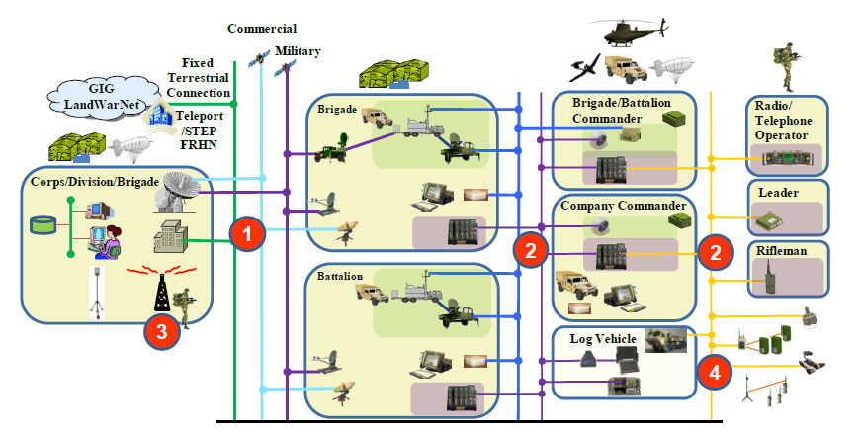
Army Tactical Network, Control Points, and the Message and TDL Standards
VMF Binary (MIL-STD-6017) specified for C2 at Tactical Edge Control Points of the Network (2 & 4)
XML/(SOAP and REST Protocols) specified at Enterprise and Stationary Control Points of the Network (1 & 3)

Slide 11




How is VMF Governed? - ACCB Membership
Chartered
Potential
CECOM LCMC – Chair
PEO Soldier
PEO Ground Combat Systems
PEO Aviation
PEO Command, Control, Communications – Tactical (C3T)
PEO Missiles and Space
PEO Intelligence, Electronic Warfare and Sensors (IEW&S)
PEO Ammunition
Training and Doctrine Command (TRADOC)
Army Material Command (AMC)
Special Operations Command (SOC)
Forces Command (FORSCOM)
Aviation and Missile Command (AMCOM)
PEO Combat Support and Combat Service Support
PEO Enterprise Information Systems
PEO Integration
PEO Simulation, Training, and Instrumentation
JPEO Chemical and Biological Defense
JPEO Joint Tactical Radio System
The Army Configuration Control Board (ACCB) coordinates The Army C2 Standards implementation position. Army Interface Change Proposals are designed, reviewed, and voted, before forwarding for Joint Services evaluation and vote.

Slide 12
Messaging Standards Governance Management
Allied
MTFWG
DLWG
BILAT
Joint
Services
JMSWG
JMTCCB
USMTF COI
RITTWG
CCIB
VMFSG
CCIB
CCIB
TRP
MDASG
CNRWG
MDASG
XMLIMSG
Army-Centric
ACCB
FSTRB
AITRB
Maintainers
Developers
TDL Users
The ACCB provides a critical link between the Army and Joint Communities

Slide 13








































Joint/NATO Standards Management
Messaging interoperability is achieved by vetting and coordinating standards and changes - first within each service, then within each nation, then thru coordinated agreements in the North Atlantic Treaty Organization (NATO)
Notes:
Messaging:
Character based (US Message Text Format [USMTF])
Binary (Variable Message Format [VMF], LINK 16, LINK 11)
Protocol: MIL-STD 188-220 and MIL-STD 2045-47001

Slide 14
MIL-STD-6017 Primary Sections
Main Volume: Scope, Applicable Documents, References, General and Detailed Requirements,
VMF Syntax
Message Map Columns (indicative specification and processing information)
Logical, Numeric, Composite, Time, Positon, Graphics, and Unit Id Data Fields
Transmit/Receive Rules, Precedence, Ack/Nack
Specification rules and logic for production of functional limited datasets (Cases and Conditions)
Section 5, Part 1 and Part
Functionally and Sequentially Ordered List of Message Specifications
Appendix B – Data Element Dictionary
Appendix C – Data Forwarding (aka MIL-STD-6020)

Slide 15
Message Specification Composition
In the following order:
Message Number : K series Message Number
Message Title: Common Reference
Message Purpose: Brief Description
Message Map: Data Element Specifications of DED Defined Identifiers; Parent/Child, Sibling Element and Group Relationships, Repeat Occurrences of Fields and Groups, Mandatory and Optional Data Fields
Message Construction and Interpretation Instructions: Cases, Conditions, and Special Considerations
VMF is a BINARY standard specification. It was developed for transmission of C2 data in low bandwidth networks, while ensuring a minimal communication footprint. Every element is “packed” to the bit level; no byte level filler.
BINARY data is typically metadata about the underlying common expression of actual data
VMF structure, and the fact that it has a DED, makes it very suitable for expression by XSD/XML

Slide 16
Example Message
MESSAGE NUMBER: K01.2
MESSAGE TITLE: UNIT DATA QUERY/RESPONSE
MESSAGE PURPOSE: TO REQUEST OR DISTRIBUTE THE DATA ASSOCIATED WITH A UNIT
REFERENCE NUMBER, UNIT LONG NAME OR UNIT SHORT NAME.
INDEX REFERENCE # GROUP REPEAT
NO. DFI/DUI DUI NAME BITS CAT CODE CODE RESOLUTION, CODING, ETC.
1. 4057 028 URN ACTION TYPE 2 M
2.1 4045 001 GRI 1 M R1(15) GRI FOR R1.
2.2 4014 002 FPI 1 M R1
2.2.1 4004 012 URN 24 X R1
2.3 4014 002 FPI 1 M R1
2.3.1 4004 013 UNIT LONG NAME 448 X R1
2.4 4014 002 FPI 1 M R1
2.4.1 4004 015 UNIT SHORT NAME 210 X R1
2.5 4014 001 GPI 1 M R1 GPI FOR G1. URN LOOK-UP.
2.5.1 4014 002 FPI 1 G1 R1
2.5.1.1 4151 002 SERVICE/AGENCY 7 X G1 R1
2.5.2 4014 002 FPI 1 G1 R1
2.5.2.1 4127 005 NATIONALITY 9 X G1 R1
2.5.3 4014 002 FPI 1 G1 R1
2.5.3.1 4173 020 SYMBOL CODE 105 X G1 R1

Slide 17
Example Message
1.1 Case: Request Data
THIS CASE REQUIRES
URN ACTION TYPE [4057/028] is specified "0" (REQUEST DATA)
AND FPI for URN [4004/012] is specified "1" (PRESENT)
XOR FPI for UNIT LONG NAME [4004/013] is specified "1"
(PRESENT)
XOR FPI for UNIT SHORT NAME [4004/015] is specified "1"
(PRESENT)
AND GPI for G1 is specified "0" (NOT PRESENT)
END CASE
…….
Conditions are IF THEN ELSE specifications

Slide 18
VMF Message Construction Flow
Apply
Mandatory Fields
(M)
Message Construction Flow
Is
Case
Specified?
Yes
Apply
Case Fields
*Optional fields those not defined by case/condition logic - User/System Supplied
**Conditions Have Order Independent Test and Applicability – Consistent value generation regardless of processing order
No
Apply
any Repeat Groups
Indicated in Case
Apply
Optional* Fields
(GPI, FPI, FRI, GRI)
Apply
Applicable**
Conditions
Notes:
*Optional fields are defined as those fields and values not defined by the chosen case logic (set arithmetic) and are either user or system supplied.
All field values are randomly generated where the field operator is defined other than “=“ such as “>, <, <=“.
**All conditions are tested and applied in lexicographic (dictionary order) sort order; such as 2.1, 2.10, 2.2 ... but evaluation order of the conditions should be order independent. (See slide 11)
Condition evaluation shall be order independent.
When implementing a message’s conditions, the final conditional values selected will be the same regardless of the processing order for each condition. Conditions shall not be order dependent.

Slide 19
K05.14
Title: Situation Report
Purpose: The situation report is submitted by subordinate units to their higher headquarters, and adjacent units as necessary, to report and define tactical situations and status
Key Logical Information:
Enemy Activity
Overall Unit and Combat Status
URN, Location, and DTG of Transmission
Equipment Categorization IAW Air, Surface, Subsurface, and Land Types
Number of Operational Vehicles
Fuel Type and Quantity
Ammunition Type and Quantity
Cases: None

Slide 20
K07.13
Title: Platform Status Report
Purpose: To Report Platform Operational Status and Fuel and/or Ammunition
Key Logical Information:
Parent Principle End Item Identification
Child Serial/Identification Number Data
Reporting Interval
Parent Fuel Information
Child Auxillary Fuel Information
Ammunition Information
Equipment Operating Time Code Data
Cases: Normal; All other Reporting Events (Startup, Shutdown, Re-Supply, etc)

Slide 21
K07.12
Title: Situation Report
Purpose: To Request, Assign, and Track (Status) of Combat Service Support Tasks
Key Logical Information:
Task Type is Mandatory Field
Request DTG and Mission Id
Start and End Time
Mission Location
Task Status
Synchronization Information and Location
Expected DTG of arrival
Cases: Call For Support; Task Order; Task Acknowledgement; Task Synchronization

Slide 22
VMF Parsers and Tools
Most VMF Parsers (message constructor and message de-constructor) are developed by the individual systems
Do not have knowledge to the extent these parsers are common and shared
SEC develops/maintains a JITC certified VMF validation tool (VTT)
SEC develops/maintains a JITC certified message generation tool (AMG)
AMG can automatically generate all min and max binary messages
AMG can generate XML variations of VMF

Slide 23
XML-VMF
Appendix F of the MIL-STD-6017 specifies an XML Standardization by example only
CECOM/SEC is developing a normative XML-VMF specification for the Army Enterprise
PEO C3T has developed very good XSDs for some of the VMF messages

Slide 24
Questions?
Notes:
The Variable Message Format (VMF) Military Standard (MIL-STD) provides military services and agencies with Joint interoperability standards, including message, data element, and protocol standards. These standards are essential for the design, development, test, certification, fielding, and continued operation of automated tactical data systems (TDSs) which support the requirement to exchange timely, critical, command and control information across Joint boundaries.
MIL-STD-6017 applies to all developmental and operational TDSs that are required to interoperate with one or more other service TDSs using VMF over any media. It contains message and data element standards for implementation on interservice VMF interfaces. MIL-STD-6017 is not intended to design or specify actual TDS or operator displays or other man-machine interfaces. The VMF Interface Operating Procedures (IOP) and the communications protocol are published separately. The IOP is briefly described in subsequent paragraphs. MIL-STD-188-220 and MIL-STD-2045-47001 address the communications protocols and procedures for the exchange of information among Digital Message Transfer Devices (DMTDs) and between DMTDs and command, control, communications, computers, and intelligence (C4I) systems participating in inter- and intra-service tactical networks.

Slide 25
BACKUP

